Slide 1

Introduction to Reliability
Dr Oliver Clark (Oli)

Slide 2
This week
This Video: Brief recap on reliability
And then:
Models of reliability:
Parallel
(Essentially) Tau Equivalent
Congeneric
Reliability Coefficients
Alpha/KD-20
Omega

Slide 3

Validity & Reliability
I make friends easily.
I am skilled in handling social situations.
I am the life of the party.
I feel comfortable around people

Slide 4
YOU KNOW ME SO WELL!
At least you tried…
WHO IS THIS???????
I guess it’s fairly good…

Slide 5

YOU KNOW ME SO WELL!
At least you tried…
WHO IS THIS???????
I guess it’s fairly good…

Slide 6
YOU KNOW ME SO WELL!
At least you tried…
WHO IS THIS???????
I guess it’s fairly good…

Slide 7

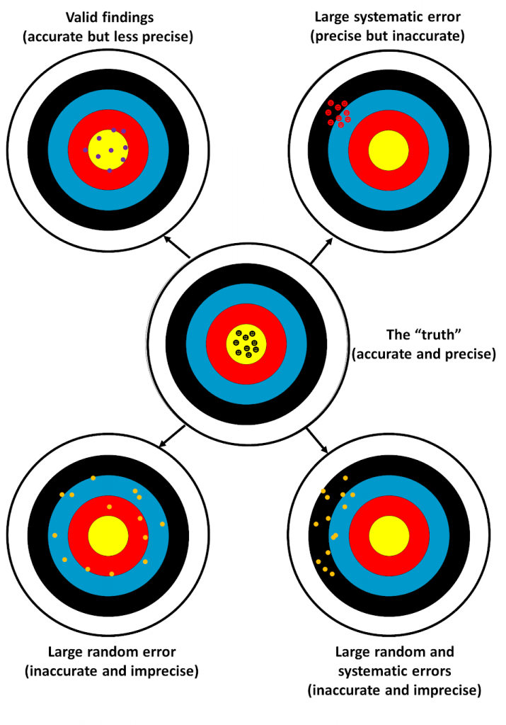
Validity & Reliability
Valid, fairly reliable
Reliable
not valid
Fairly valid,
Not reliable
Not valid
Not reliable

Slide 8
Validity & Reliability
Valid, fairly reliable
Reliable
not valid
Fairly valid,
Not reliable
Not valid
Not reliable

Slide 9

Reliability
Reliability has been defined as ‘the extent to which results are consistent over time… and if the results of a study can be reproduced under a similar methodology, then the research instrument is considered to be reliable.’ (Joppe, 2000).

Slide 10

Test-retest reliability
Consistency across time. How much a test can produce similar scores on subsequent trials over time
Influenced by time between tests
Can be influenced by participants remembering items on the original
Are questions ambiguous, or phrased in a way where responses are easily influenced by other factors?

Slide 11

Parallel Forms Reliability
Present two different tests that have parallel items

Slide 12
Internal reliability
How consistently all the items in a scale measure the concept in question.
If scale is internally reliable then any subset of items from the scale could be selected and they will provide a measure of the construct that is similar if any other items were selected.
a) Split-half reliability
Looking at first half of items and second half of items (per each participant) do they correlate well with one another?
i) Odd-even reliability
Looking at a set of scores –do the odd and even questions correlate well?

Slide 13
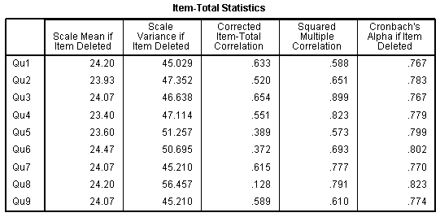
Internal reliability (consistency)
Cronbach’s a (alpha)
Cronbach’s alpha is a test used to estimate the reliability, or internal consistency of a measure
It will provide a ‘score’ of internal reliability for each of the items in a measure
The Cronbach’s α result is a number between 0 and 1. An acceptable reliability score is one that is 0.7 and higher (.90 and above is best)

Slide 14
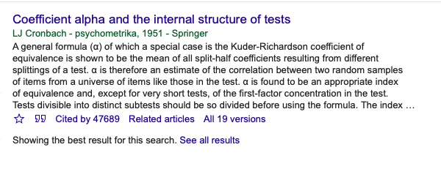
Internal reliability
Alpha is often used as a default
Conflated with reliability AND validity
Should only be used in certain scenarios

